Slide 1
Weather System Generation

Slide 2
Motivation

Slide 3
—Haley Newlin
“One of the biggest mistakes writers make in developing their story is neglecting the importance of setting. Character, plot, and dialogue are all essential to story progression; however, so is setting. It serves a purpose far beyond a backdrop for the action. Setting can frame mood, meaning, and thematic connotations.”

Slide 4
01
02
AIMS
RISKS
03
04
WORK SO FAR
SUMMARY
Features that will be included and set timetable
Possible obstacles that I will look out for
Progress so far
Review of all that was discussed

Slide 5
01.
Aims
My ambitions for this project

Slide 6

A complete weather system
Key features
Lightning, fog, volumetric clouds, aurora borealis
Weather zone presets
Ambient sound
Is customizable
Day-night cycle
3D and 2D option

Slide 7
TIMELINE
Execute
Review
Decide on a final list of features and begin implementation 05.01-20.03.2021
Act on feedback and refine current features 30.03-05.05.2021
Learn about how this problem has been tackled in the past 20.10~20.12.2020
Submit prototype for review and get user feedback 20.03-30.03.2021
Produce a final instance of the project 05.05.-07.05.2021t
Research
Evaluate
Submit

Slide 8
.02
Risks
Possible obstacles
and how I plan to overcome them

Slide 9
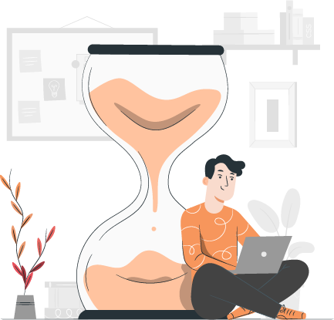
Delivering on time

Slide 10
Poor performance

Slide 11
03.
Work so far

Slide 12
CURRENT PROGRESS
Prototype
Got familiar with Unity
Research
Began researching different ways of incorporating weather parameters together
Began work on a prototype weather system, using a particle system in Unity that will simulate rain as a first step

Slide 13
.04
Summary

Slide 14
REVIEWING CONCEPTS
Motivation
Development
Feedback
Desire to create a tool that can easily integrate weather into unity games
Will use agile methodology
Will take and act on feedback provided by users

Slide 15
THANKS!

Slide 16
References
Illustrations: Stories by Freepik
Pack E-learning
Designer girl concept illustration
Social media
Documents
Statistics
Blogger post
At work
Business landing page
Business landing page
Business landing page
Resume

